Slide 1
Image Segmentation
U-Net
Analysis
Image Segmentation
Eunju Lee
Department of Statistics
Pusan National University
December 8, 2021
Eunju Lee
Image Segmentation

Slide 2
1. Image Segmentation

Slide 3
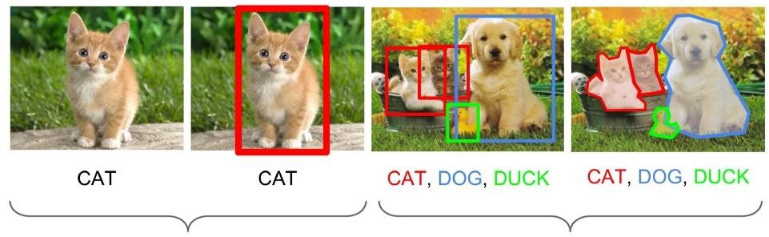
Image Segmentation
U-Net
Analysis
Image Analysis
Classification
Object Detection
Instance Segmentation
Eunju Lee
Image Segmentation

Slide 4
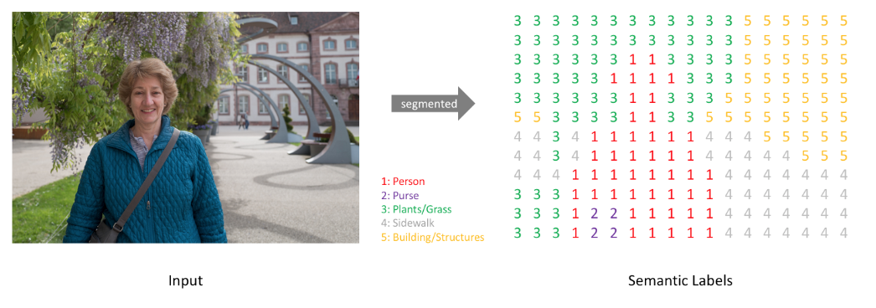
Image Segmentation
U-Net
Analysis
Image Segmentation
[ Dense Prediction ]
Eunju Lee
Image Segmentation

Slide 5
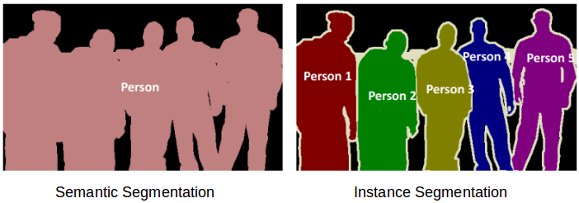
Image Segmentation
U-Net
Analysis
Image Segmentation
Eunju Lee
Image Segmentation

Slide 6
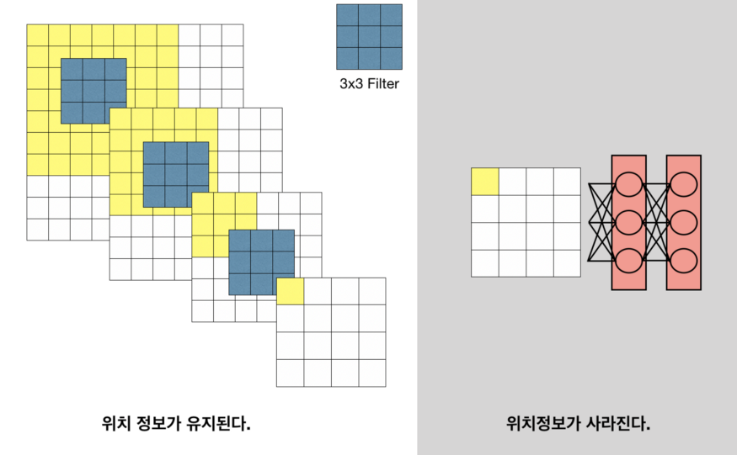
Image Segmentation
U-Net
Analysis
Classification model Segmentation model
① Convolutionalization
Fully Connected Layer
Eunju Lee
Image Segmentation

Slide 7
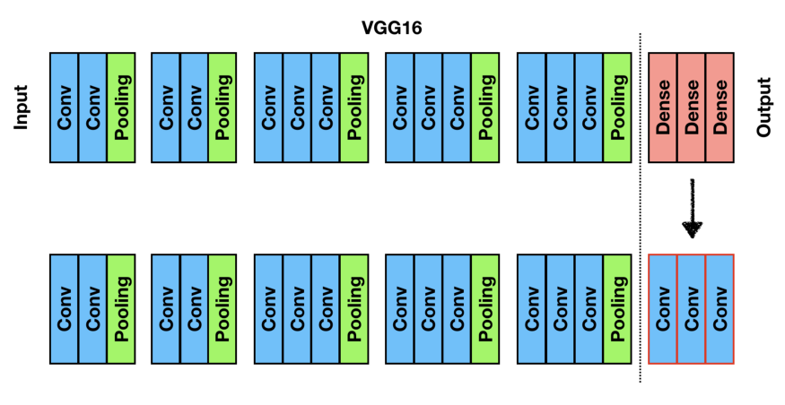
Image Segmentation
U-Net
Analysis
Classification model Segmentation model
① Convolutionalization
위치정보 내포
Eunju Lee
Image Segmentation

Slide 8
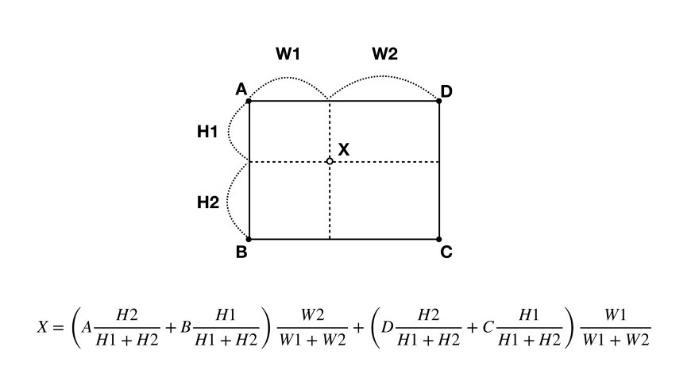
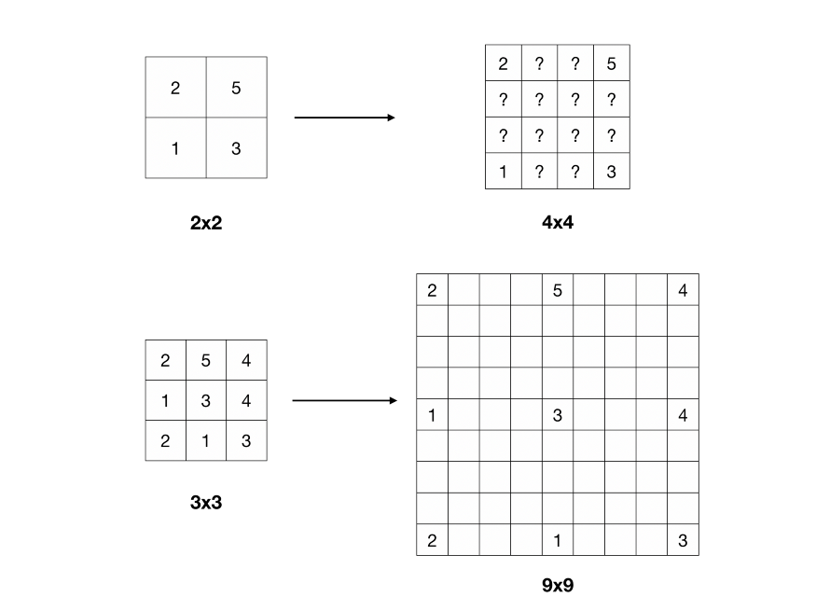
Image Segmentation
U-Net
Analysis
Classification model Segmentation model
② UpSampling
※ Bilinear Interpolation
Eunju Lee
Image Segmentation

Slide 9
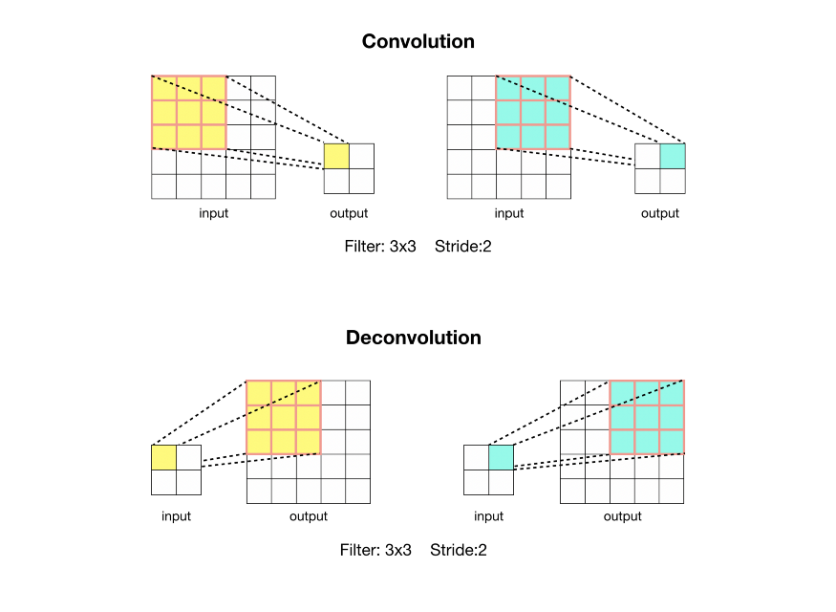
Image Segmentation
U-Net
Analysis
Classification model Segmentation model
② UpSampling
※ Deconvolution
Eunju Lee
Image Segmentation

Slide 10
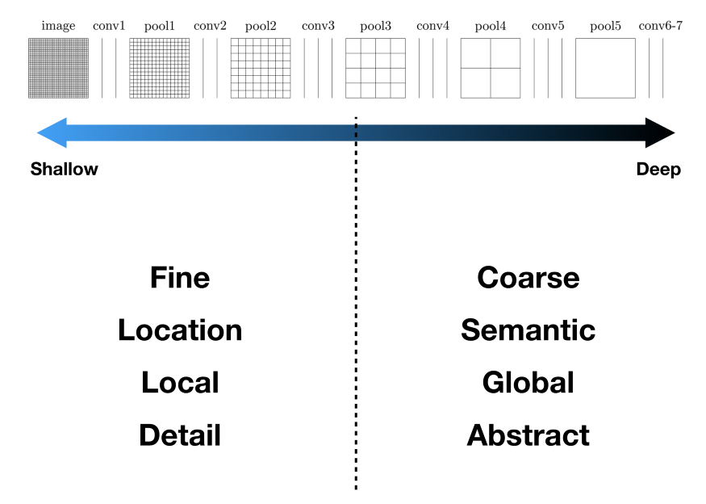
Image Segmentation
U-Net
Analysis
Classification model Segmentation model
③ Skip Architecture
Eunju Lee
Image Segmentation

Slide 11
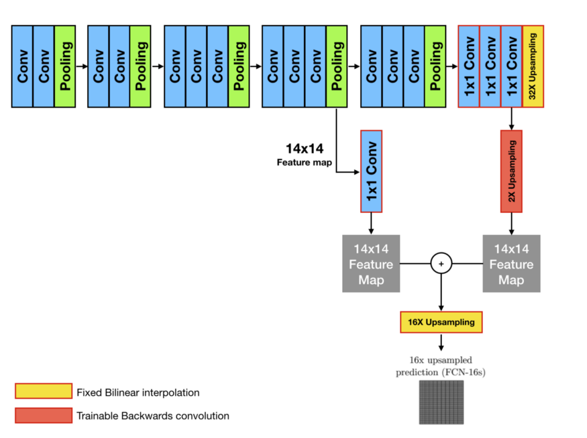
Image Segmentation
U-Net
Analysis
Classification model Segmentation model
③ Skip Architecture
Eunju Lee
Image Segmentation

Slide 12
2. U-Net

Slide 13
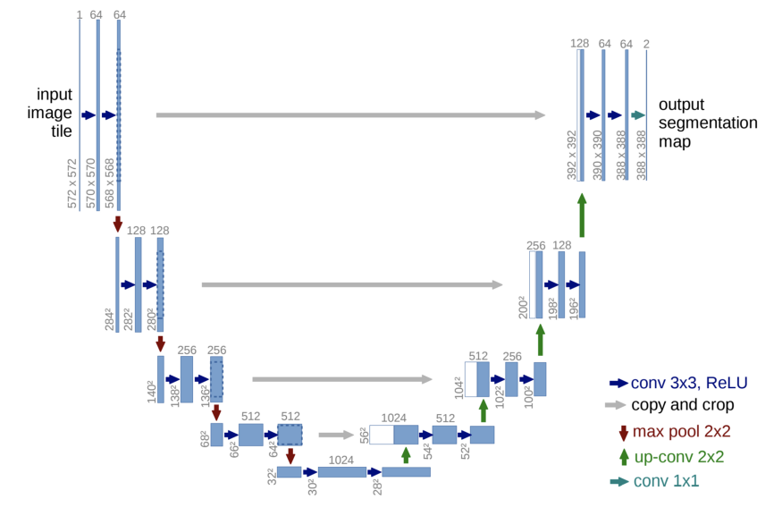
Image Segmentation
U-Net
Analysis
U-Net
Eunju Lee
Image Segmentation

Slide 14
Image Segmentation
U-Net
Analysis
U-Net
Contracting Path
: 이미지의 전반적인 Context 정보
3x3 convolutions 반복
Activation Function : ReLU
2x2 max-pooling (stride: 2)
Down-sampling
Eunju Lee
Image Segmentation

Slide 15
Image Segmentation
U-Net
Analysis
U-Net
1x1 convolution
Expanding Path
: 높은 해상도의 Output을 얻기 위한 Up-sampling
2x2 convolution (“up-convolution”)
3x3 convolutions 반복
Activation Function : ReLU
Skip Architecture
Eunju Lee
Image Segmentation

Slide 16
3. Analysis

Slide 17
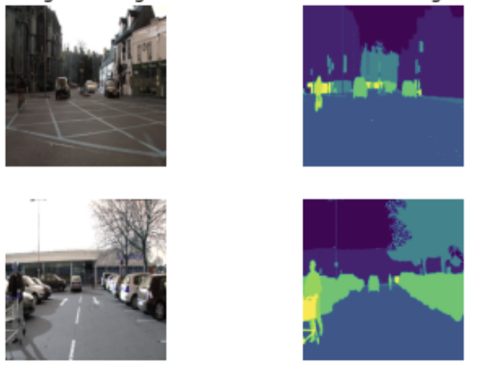
Image Segmentation
U-Net
Analysis
0. Data
X = Original Image
Y = Masked Image
Train : 367개, Test : 101개
Image size : 224 × 224
Class : 12개 ( 사람, 건물, 자동차, 나무 등)
Eunju Lee
Image Segmentation

Slide 18
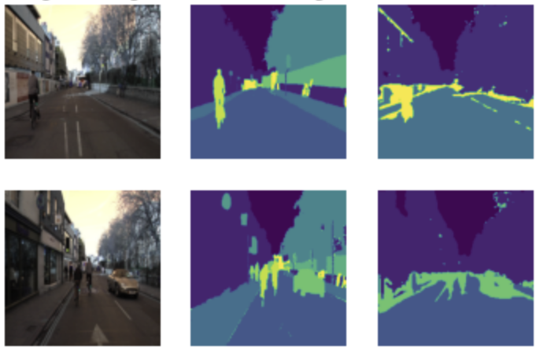
Image Segmentation
U-Net
Analysis
1. U-Net
Original Image
Masked Image
Predicted Masked Image
 | Train | Validation
Loss | 0.9456 | 0.9541
Accuracy | 0.7016 | 0.6833
Test Accuracy : 0.5961
Eunju Lee
Image Segmentation

Slide 19
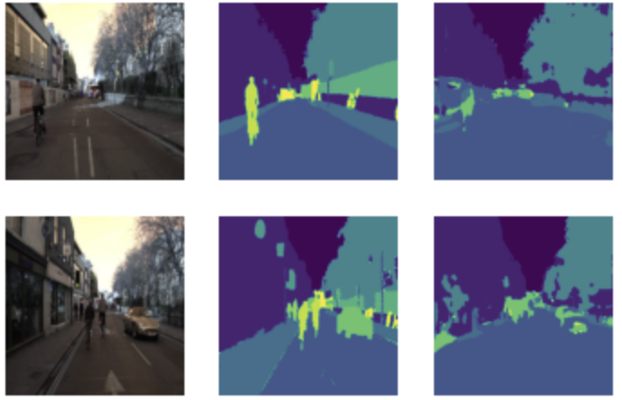
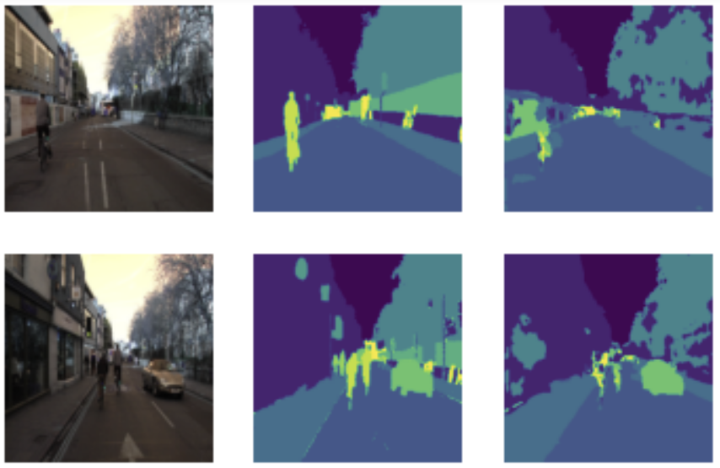
Image Segmentation
U-Net
Analysis
1. U-Net
※ Batch Normalization
※ Batch Normalization & Dropout
 | Train | Validation
Loss | 0.5300 | 1.0207
Accuracy | 0.8435 | 0.7460
 | Train | Validation
Loss | 0.5473 | 0.8628
Accuracy | 0.8388 | 0.7478
Test Accuracy : 0.7396
Test Accuracy : 0.8055
Eunju Lee
Image Segmentation

Slide 20
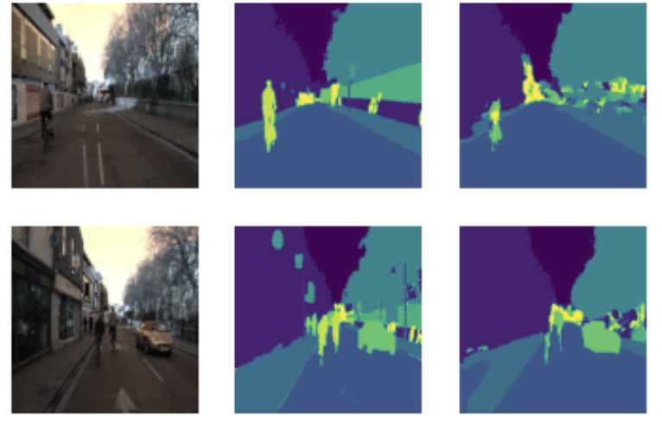
Image Segmentation
U-Net
Analysis
2. U-Net based on pretrained VGG16
※ Base Model : Pretrained VGG16
Original Image
Masked Image
Predicted Masked Image
 | Train | Validation
Loss | 0.4270 | 0.4992
Accuracy | 0.8788 | 0.8617
Test Accuracy : 0.8550
Eunju Lee
Image Segmentation

Slide 21
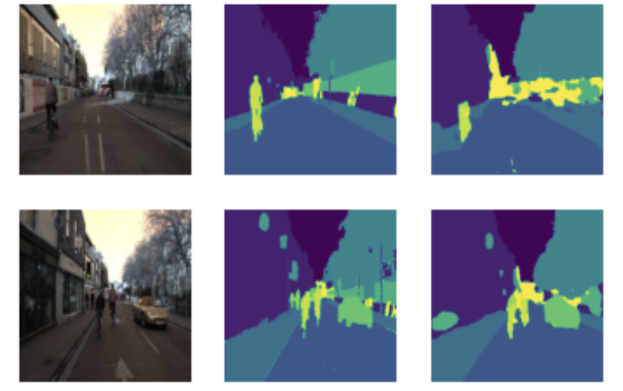
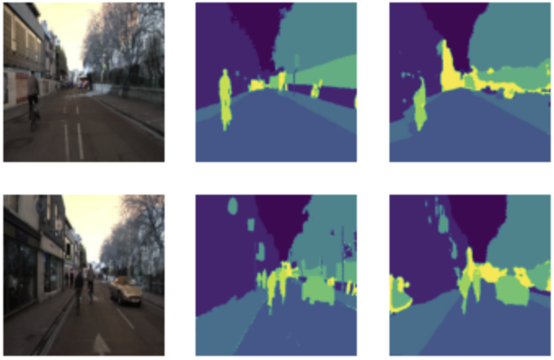
Image Segmentation
U-Net
Analysis
2. U-Net based on pretrained VGG16
※ Batch Normalization
※ Batch Normalization & Dropout
 | Train | Validation
Loss | 0.3464 | 0.4996
Accuracy | 0.9001 | 0.8588
 | Train | Validation
Loss | 0.3530 | 0.5465
Accuracy | 0.8992 | 0.8345
Test Accuracy : 0.8553
Test Accuracy : 0.8643
Eunju Lee
Image Segmentation

Slide 22
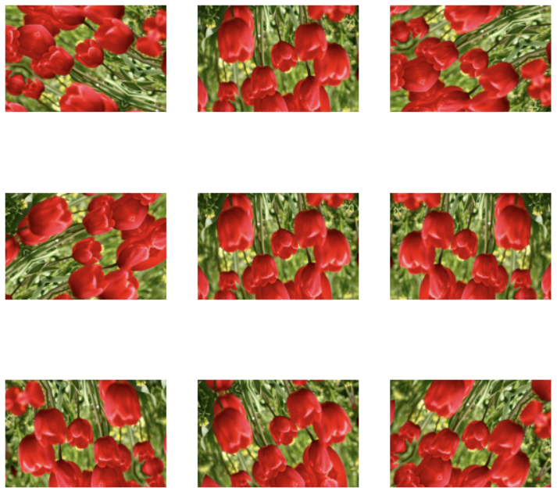
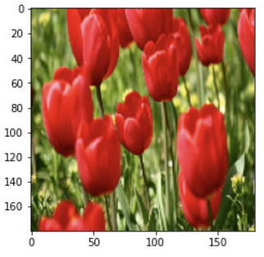
Image Segmentation
U-Net
Analysis
3. Data Augmentation
367개 Train Data → Small Data
: 원본의 각종 변환을 통해 Data 개수를 증대
Eunju Lee
Image Segmentation

Slide 23
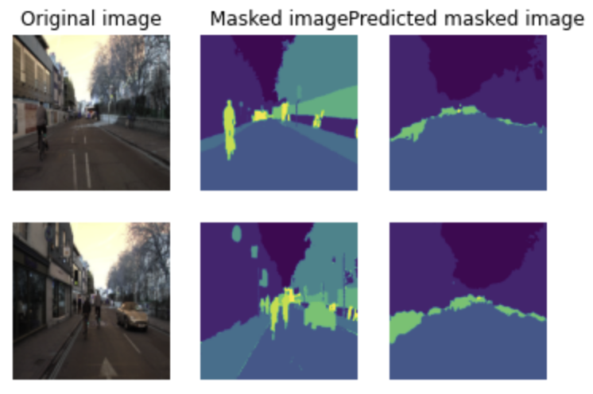
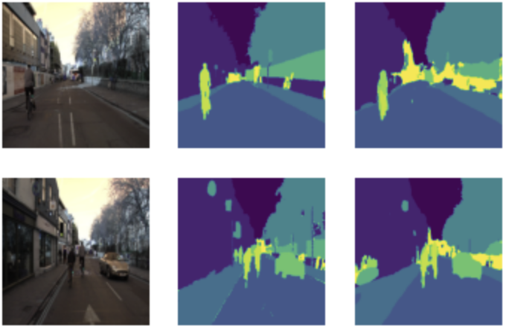
Image Segmentation
U-Net
Analysis
3. Data Augmentation
※ Rotation
※ Bright
 | Train | Validation
Loss | 1.0262 | 1.0956
Accuracy | 0.6660 | 0.6383
 | Train | Validation
Loss | 0.2617 | 0.3755
Accuracy | 0.9253 | 0.8988
Test Accuracy : 0.5816
Test Accuracy : 0.8684
Eunju Lee
Image Segmentation

Slide 24
Conclusion

Slide 25
Conclusion
Test Accuracy | Basic | Batch Normalization | Batch Normalization & Dropout
U-Net | 0.5961 | 0.7396 | 0.8055
VGG16 U-Net | 0.8550 | 0.8553 | 0.8643
VGG16 U-Net (Batch Normalization & Dropout) | Rotation | Bright
VGG16 U-Net (Batch Normalization & Dropout) | 0.5816 | 0.8684
Eunju Lee
Image Segmentation

Slide 26
Thank You!

Slide 27
Code & Reference
[ Code ]
https://colab.research.google.com/drive/1RG5CXrgOhkt5HbLsiNJQlaSAx6HOMVFx?usp=sharing
https://colab.research.google.com/drive/1lbPIw2R4KxNkx5qXaXPlEKz_Qe841rpq?usp=sharing
[ Reference ]
Jonathan Long, Evan Shelhamer, Trevor Darrell. 2015.
:Fully Convolutional Networks for Semantic Segmentation
Olaf Ronneberger, Philipp Fischer, Thomas Brox. 2015.
:U-Net: Convolutional Networks for Biomedical Image Segmentation
zhixuhao. 2018. Github:unet
:https://github.com/zhixuhao/unet/blob/master/model.py

